Slide 1
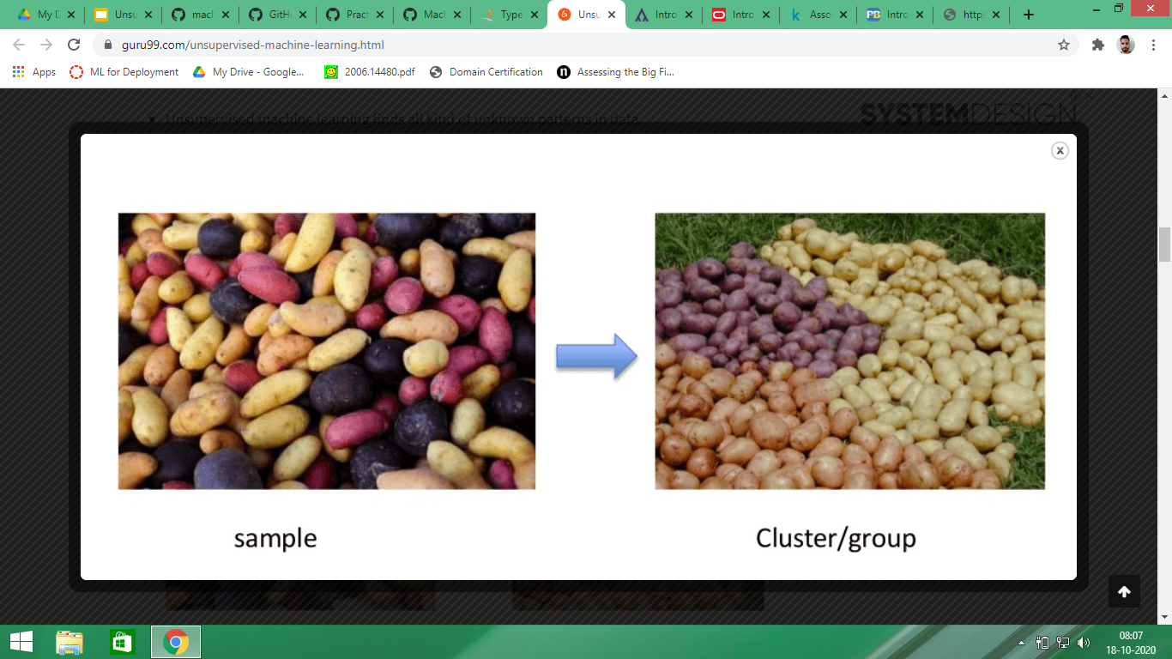
CLUSTERING
The method of identifying similar groups of data in a data set is called clustering.
It deals with finding structures in a collection of unlabelled dataset.
We look at the data and then try to club similar observations and form different groups.

Slide 2
TYPES OF CLUSTERING
Hierarchical Clustering :- It involves creating clusters that have predetermined order from top to bottom.
K-Means:- In K-means clustering first we select the desired number of clusters(K) then we divide our clusters into K-groups.
Dimensionality Reduction Techniques(PCA) :- We use dimensionality reduction techniques to reduce the dimensionality of the dataset by transforming large set of variables into smaller ones that still contains most of the information

Slide 3
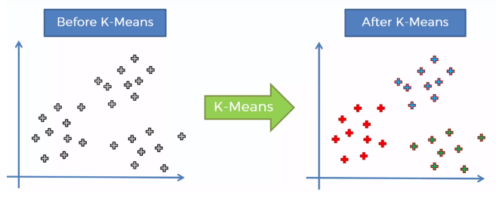
K-MEANS CLUSTERING
K-means clustering is a type of unsupervised learning .
The goal of this algorithm is to find similar groups in data. The number of groups is represented by variable K.
It is an iterative process. It assigns each data point to one of k groups .
Data points are clustered based on feature similarity.

Slide 4
K-MEANS CLUSTERING
STEP - 1
Choose the number k (number of clusters).
STEP - 2
Select K random points from data as centroids.
STEP - 3
Assign each point to the nearest cluster centroid
STEP - 4
Calculate centroid of newly formed cluster.
Repeat step 3 and 4 until the centroids of newly formed clusters does not change.
STEP - 5

Slide 5
Choosing the right value of K
K = 2
K = 4
Total possible clusters are number of data points.

Slide 6
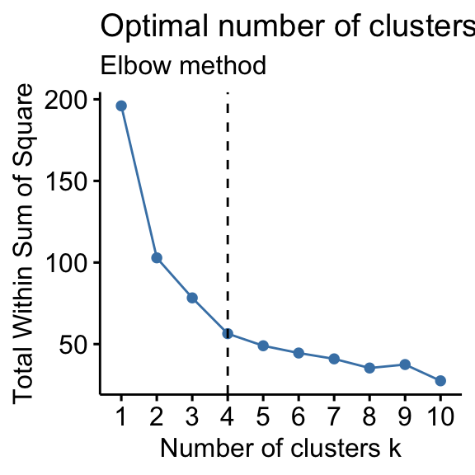

Slide 7

How to evaluate our clusters ?

Slide 8
So to recall the first properties of clusters.
All the data points within cluster should be similar to each other. In other words there should be very less distance between data points within the clusters.
D1
D2
INERTIA
Calculate sum of distances of each point from the centroid
INTRA CLUSTER DISTANCE

Slide 9
As inertia actually calculates the sum of distances of all the points within a cluster from the centroid of that cluster. The lesser the inertia value, the better the clusters.
DUNN INDEX
It takes into account the distance between clusters along with the distance within clusters.The more the value of the Dunn index, the better will be the clusters
INTER CLUSTER DISTANCE
Dunn Index = MIN(inter cluster distance) / MAX(intra cluster distance)
In order to maximize the value of the Dunn index, the numerator should be maximum. Here, we are taking the minimum of the inter-cluster distances. So, the distance between even the closest clusters should be more which will eventually make sure that the clusters are far away from each other.

Slide 10
HIERARCHICAL CLUSTERING
Hierarchical clustering is an algorithm that groups similar objects into groups called clusters.
In hierarchical clustering each point is a cluster initially.
A
B
C
D
E
F
We cluster the points into one cluster based on similarity measure.

Slide 11
A
B
C
D
E
F
DENDROGRAM
We keep on clustering each point and finally have 1 single cluster.
A
B
C
D
E
F
A
B
C
D
E
F
A
B
C
D
E
F
A
B
C
D
E
F

Slide 12
DECIDING NUMBER OF CLUSTERS
DRAW A LINE CUTTING THROUGH THE TALLEST VERTICAL LINE
CLUSTERS = 2
A
B
C
D
E
F

